Slide 1
ISC + Open-Channel SSD
BAI Shuhan

Slide 2
1
INSIDER

Slide 3
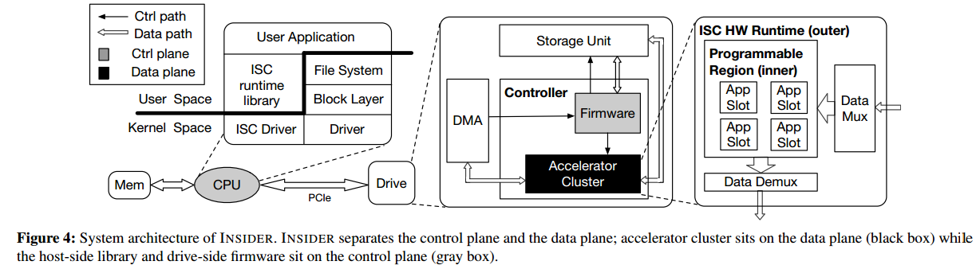
INSIDER
FPGA-based ISC Unit : high reconfigurability / high energy efficiency / support massive parallelism → take both performance and flexibility into account
inside FPGA : hardware-isolation (offloading tasks into different app slot); parallelism (high reconfigurability) (data-level paralparallelism (replicating the processing elements to construct SIMD units) / pipeline-level parallelism (constructing a deep hardware pipeline))
host side : virtual file abstraction → abstract ISC as file operation → no need to develop customized API → reduce the difficultly of programming
drive-side : separate the control / data plane → compute-only abstraction → no need to focus on the details of underlying data movement → reduce the difficultly of programming

Slide 4
INSIDER
FPGA-based ISC Unit : high reconfigurability / high energy efficiency / support massive parallelism → take both performance and flexibility into account
inside FPGA : hardware-isolation (offloading tasks into different app slot); parallelism (high reconfigurability) (data-level paralparallelism (replicating the processing elements to construct SIMD units) / pipeline-level parallelism (constructing a deep hardware pipeline))
OCSSD：give hosts control over
drives' inside
host side : virtual file abstraction → abstract ISC as file operation → no need to develop customized API → reduce the difficultly of programming
drive-side : separate the control / data plane → compute-only abstraction → no need to focus on the details of underlying data movement → reduce the difficultly of programming

Slide 5
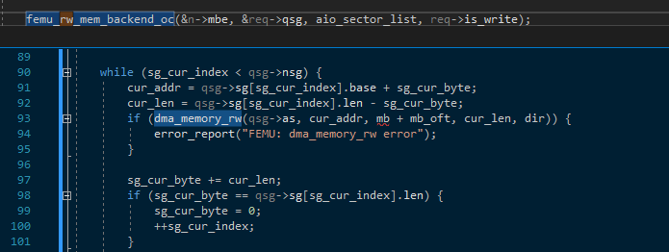
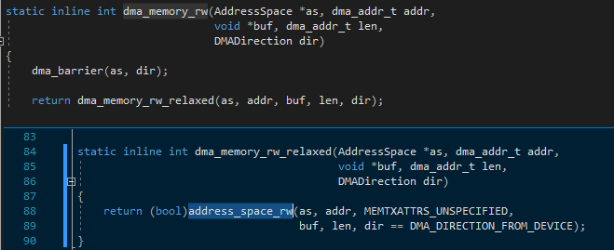
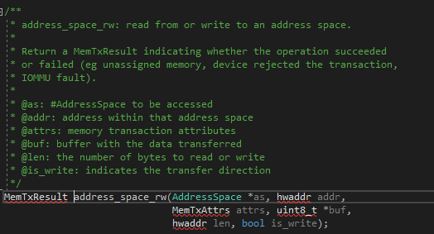
Adding an easy computation thread to test
Finding the place (in FEMU codes) to intercept data:

